Slide 1
Effect of Alternative Splicing on DNA Binding of Transcription Factors
Shariq Madha

Slide 2
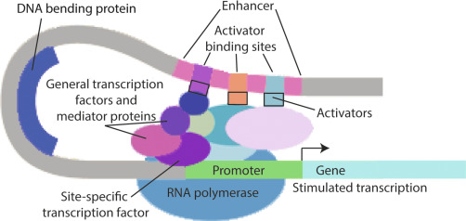
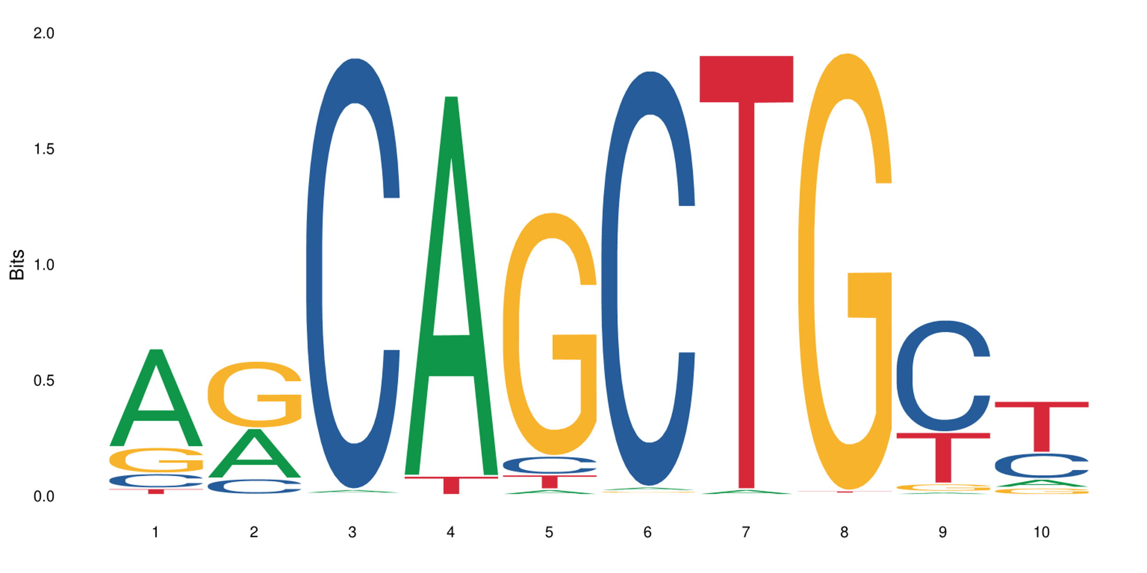
Transcription factors
Regulate the expression of specific genes
Form complexes with other proteins/TFs to promote the expression of a gene
Generally located within 10kb of its gene
TFs bind to specific motifs
For example, CAGCTG for ASCL2
Mobley, et al. 2019
JASPAR

Slide 3
Alternative Splicing
Method for genes to produce alternative forms
Exons may be included, removed, or cut off to change the resulting protein product
Different forms are called isoforms
Exon 1
Exon 2
Exon 3
Exon 4
Isoform A
Exon 1
Exon 2
Exon 4a
Isoform B
Exon 1
Exon 3
Exon 4b

Slide 4
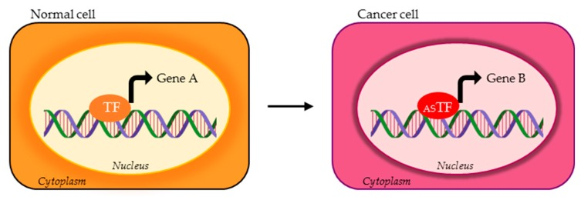
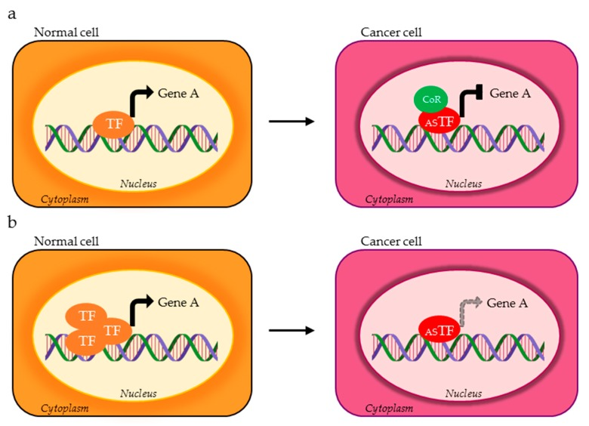
Alternate splicing effects
Bind to alternative locations
Change protein-protein interactions
Change in efficiency
Belutti, et al. 2020

Slide 5
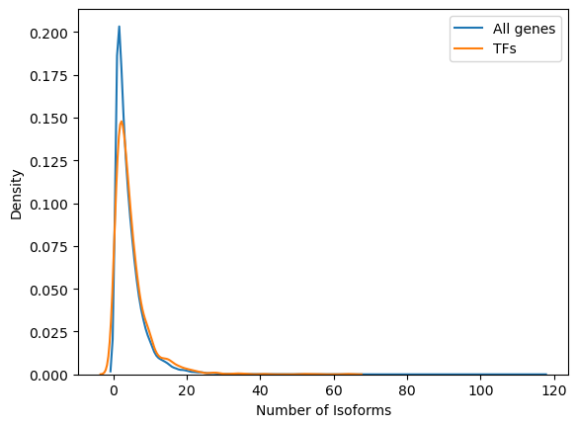
Alternative Splicing of Transcription Factors
There is a slightly higher number of AS isoforms in human TFs than overall, on average 4.9 isoform/gene vs. 4.4 isoform/gene
Has been associated with diseases such as muscular dystrophy or cancer

Slide 6
Plan
Obtained isoform sequence and domain information
Generated superisoform for each gene
Aligned each isoform to its gene’s superisoform
Calculated Alternative Splicing Impact Factor per isoform
Combined ASIF per gene and tissue
Notes:
Get a list of contributing factors to how different parts of the protein are relevant and important
"Elementtary function"

Slide 7
Identify list of TFs
Curated list provided by Gloria Sheynkman
From Sachi, et al., Juan, et al., Lambert, et al., and Transfac
List of 1582 TF's
Notes:
Gloria said this list was the standard

Slide 8
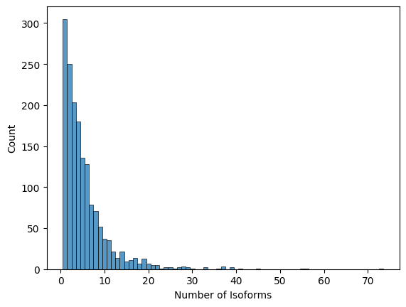
Download Isoform Sequences
Curated list of 1582 TF’s from Gloria Sheynkman
13 unusable, so 1569 total​
Average of ~5.6 isoforms per TF
TCF4 has 73 protein coding isoforms
Notes:
Isoform stability on these
Check non-sense mediated decay

Slide 9
Identify the Domain Regions
Based on SUPERFAMILY domains
Manually annotated whether a domain was DNA-binding based on its Interpro description
Overall, ~89.4% of genes have at least one isoform with a DNA binding domain
~63.3% of isoforms have a DNA binding domain

Slide 10
Identify the Domain Regions (con't)
To simplify domain classification, classified domains based on type
DNA Binding
PPI
Regions classified based on their names
For PPI, using 3DID
Also including DNA binding site information from BioLiP
Notes:
Check what makes transcriptional regulation what it is

Slide 11
Constructing a "Superisoform"
An amalgamation of all "exons" of the gene
Makes it easier for calculation of impact factor when compared to a canonical reference as it only involves removals of sections, no additions or alterations
Two methods
Multiple sequence alignment of all the isoforms, not allowing for mismatched sequence and taking the resulting consensus sequence
Take all the coding sequences, extract that sequence and translate it
Annotate the "superisoform" with the domains of the isoforms and calculate the impact factor

Slide 12
Superisoform Pseudocode
Exons only include CDS
For exons in isoforms:
i = 0
while i < number of exons:
If len(CDS[i])%3!=0:
CDS[i+1] = CDS[i][-len(CDS[i])%3:] + CDS[i+1]
Keep track of how much was added from where
Append all exons from all isoforms to each other
Sort and remove redundancy
Translate each sequence
Concatenate translated sequences
ATG GAC ATT
CT
A GCT ACT

Slide 13
Superisoform
Isoform A
An amalgamation of all "exons" of the gene
Later alignment only has deletions
Annotate the "superisoform" with the domains of the isoforms and calculate the impact factor
Exon 1
Exon 2
Exon 4a
Isoform B
Exon 1
Exon 3
Exon 4b
Superisoform
Exon 1
Exon 2
Exon 3
Exon 4a
Exon 4b

Slide 14
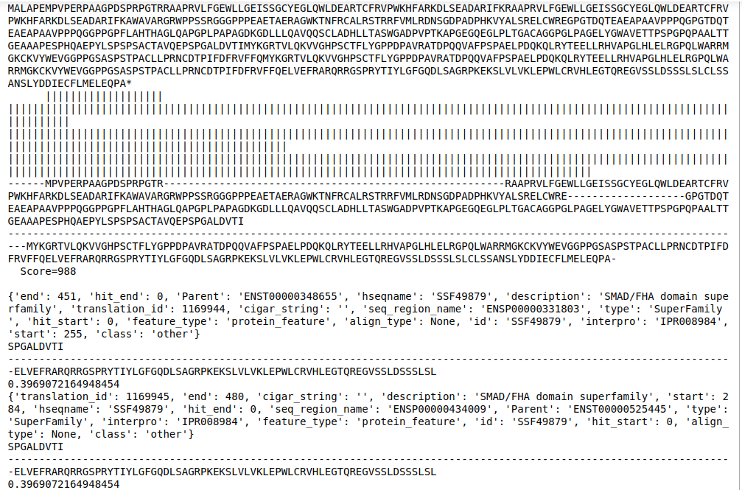
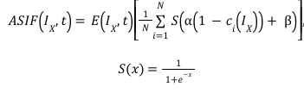
Impact Factor Calculation
Ix is an isoform
ci(Ix) is the preserved fraction of the i-th domain
E(Ix,t) is the expression value of IX in tissue t
S(x) is the sigmoid function
α is the scaling ratio of the sigmoid function input
β is the offset of the sigmoid function input

Slide 15
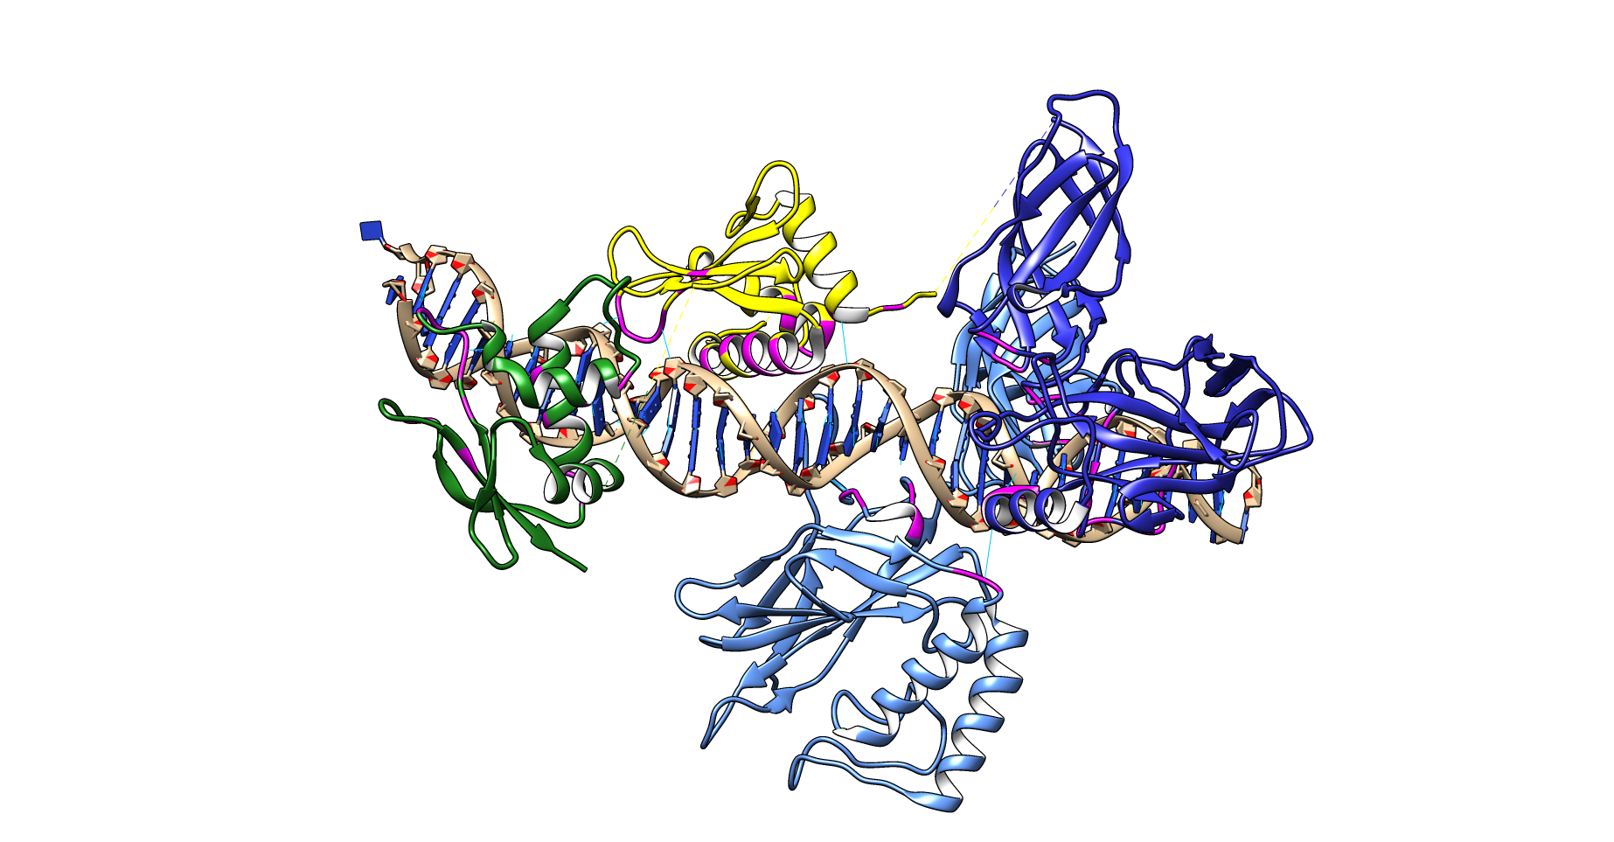
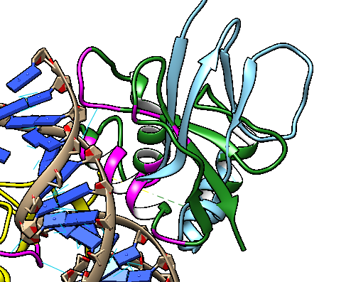
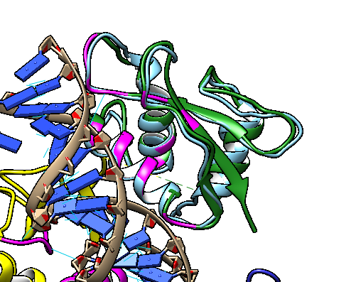
NFkB + IRF7 + IRF3

Slide 16
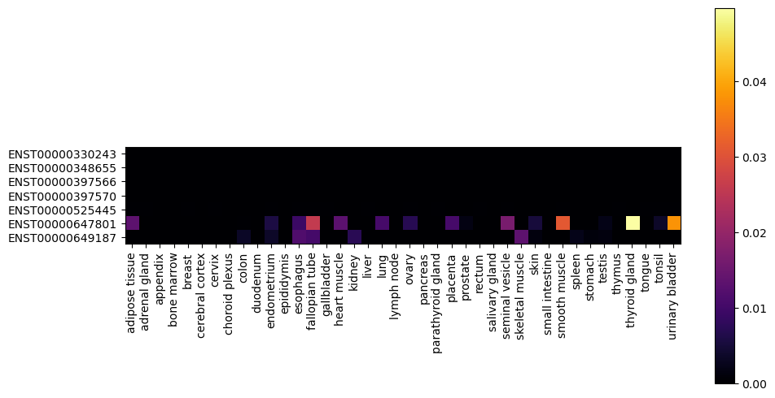
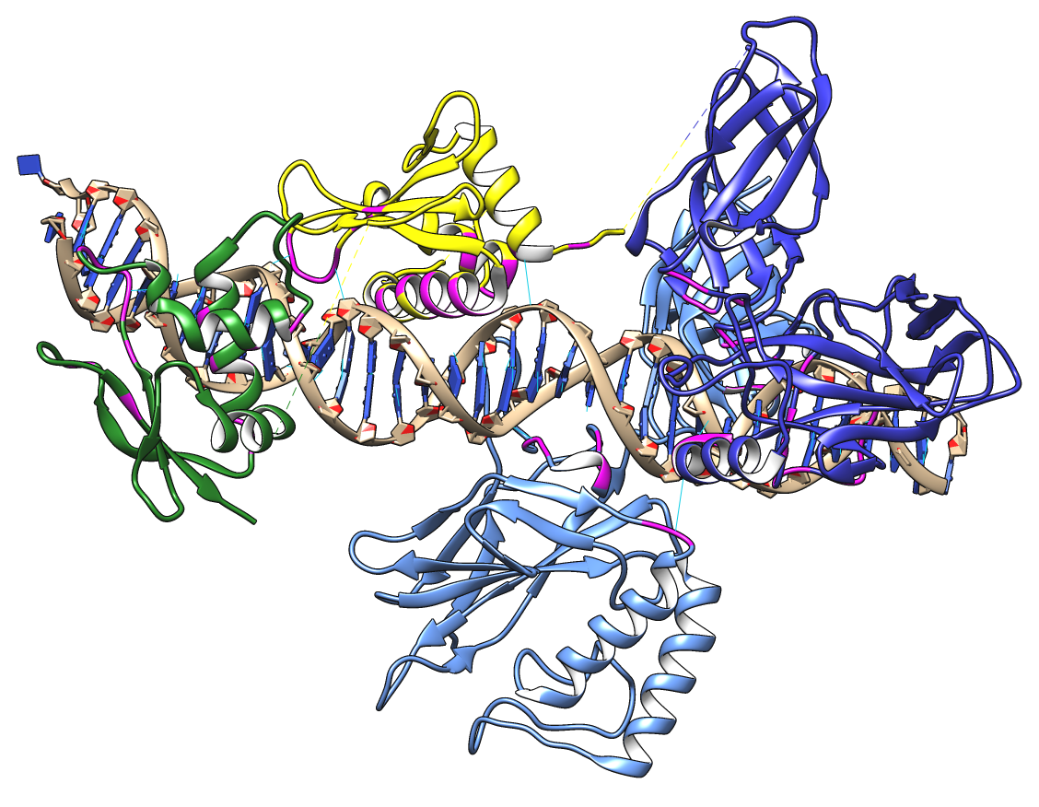
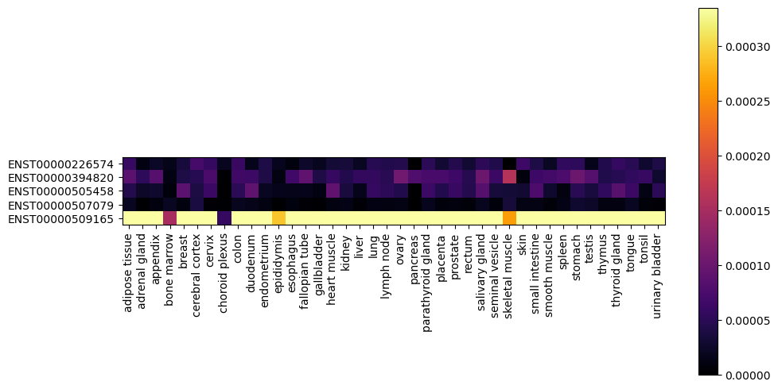
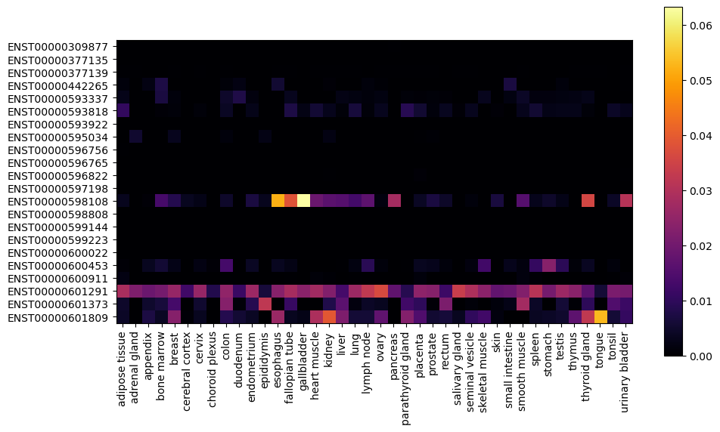
Case Study
IRF7
NFkB
IRF3

Slide 17
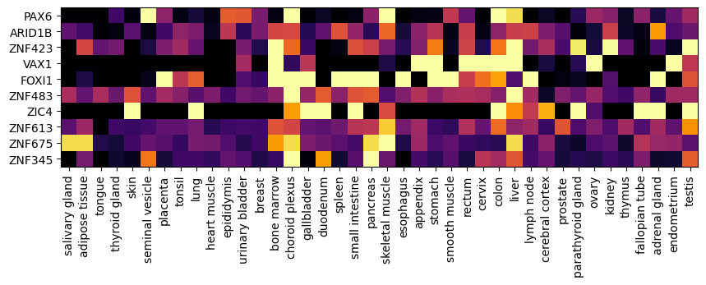
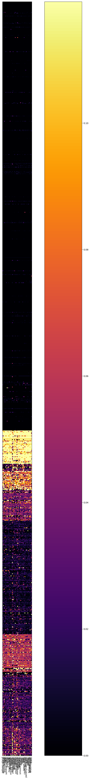
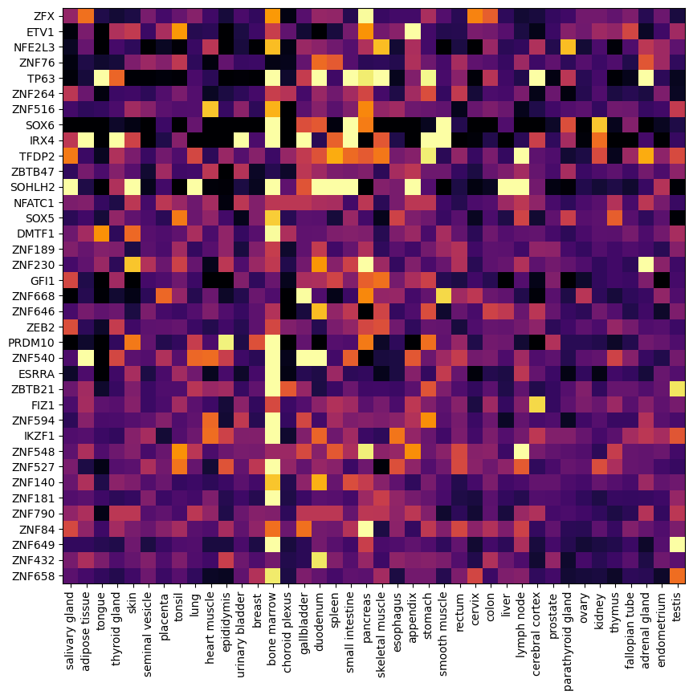
Overall Results
One Gene: One Product

Slide 18
NFkB + IRF7 + IRF3 case study
Have a PDB of all three complexed with a DNA molecule
All three have multiple isoforms represented in the dataset
Their isoform structures can be retrieved from the Alphafold database
They also have independent structures on the PDB

Slide 19
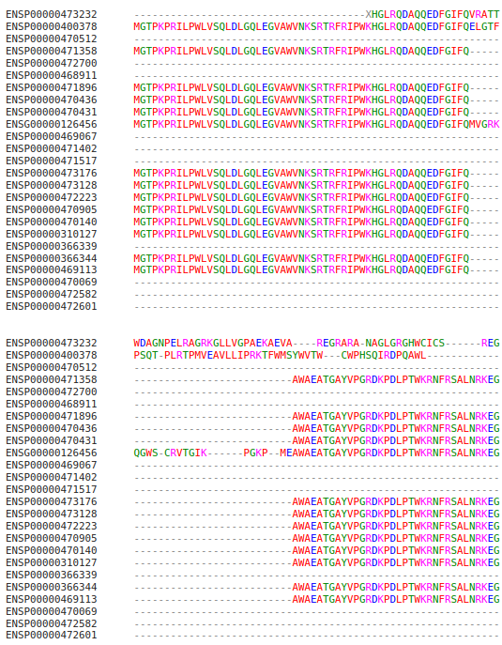
Alignment IRF3
Notes:
https://www.ebi.ac.uk/Tools/services/web/toolresult.ebi?jobId=clustalo-I20230331-123427-0220-64890445-p1m&showColors=true&tool=clustalo

Slide 20
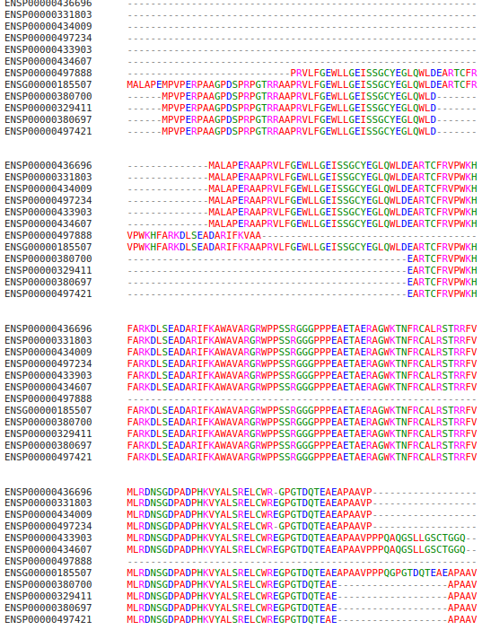
Alignment IRF7
Notes:
https://www.ebi.ac.uk/Tools/services/web/toolresult.ebi?jobId=clustalo-I20230331-130859-0521-99318014-p1m&showColors=true&tool=clustalo

Slide 21
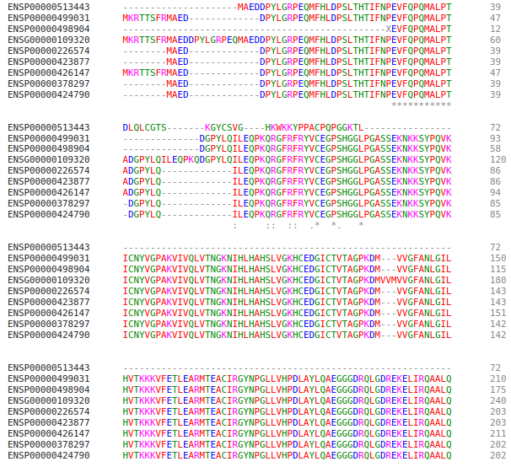
Alignment Nf-κB
Notes:
https://www.ebi.ac.uk/Tools/services/web/toolresult.ebi?jobId=clustalo-I20230331-130859-0521-99318014-p1m&showColors=true&tool=clustalo

Slide 22
Sidorov thesis
Recently published thesis that has a lot of overlap in topic with my work
“A computational study of nucleosomal binding and alternative isoforms of human transcription factors”
Does more broad, but surface-level analysis
Verified that TFs have more isoforms on average than other types of proteins
Used Interpro to classify domains, more in-depth than I have done
Looks at DBD more than any other type
Basically does a literature review of the other types

Slide 23
Acknowledgments
Korkin Lab
Dmitry Korkin
Ziyang Gao
Vasilii Gorbunov
Senbao Lu
Katy Monopoli
Huaming Sun
Winnie Kandawire
Gloria Sheynkman

Slide 24
References
https://www.frontiersin.org/articles/10.3389/fmolb.2022.920492/full
https://www.nature.com/articles/ncomms1303
Arabidopsis example of alternative splicing causing reduced binding activity
https://www.ncbi.nlm.nih.gov/pmc/articles/PMC7140685/
Review article detailing the effects of alternative isoforms of TFs in cancer
https://academic.oup.com/bib/article-abstract/23/2/bbab564/6509729?redirectedFrom=fulltext
Sequence-based DNA binding site prediction using AlphaFold2 (full access on campus)
Biorxiv version: https://www.biorxiv.org/content/10.1101/2021.08.25.457661v2.full
https://www.cell.com/cell-reports/pdf/S2211-1247(20)31014-7.pdf
Looking at tissue-specific binding sites for TFs
https://pubmed.ncbi.nlm.nih.gov/29425488/
For the list of TFs at http://humantfs.ccbr.utoronto.ca/download.php
https://ensemblrest.readthedocs.io/en/latest/
Ensembl database API documentation
SUPERFAMILY database
https://supfam.org/SUPERFAMILY/howto_use_database.html
File 2015-01-22_sfdb.sql.gz
SUPERFAMILY with hmmer usage https://supfam.org/SUPERFAMILY/howto_use_models.html
http://hmmer.org/ accessed Nov 9, 2022
http://scop.mrc-lmb.cam.ac.uk/ accessed Nov 9, 2022 for SCOP2 files
https://pubmed.ncbi.nlm.nih.gov/21720952/
The domains of importance in TFs
https://www.ncbi.nlm.nih.gov/pmc/articles/PMC2020837/
Paper that produced the case-study pdb

